Slide 1

TAGETIK
Develop a Go to market strategy and launch an internal new practice
Action plan 2019

Slide 2
Objective /Risks / Opportunities
Objective
Develop a new EPM technology offer within FPM360, in addition of SAP BPC and IBM PA
Opportunities
Tagetik is a new player in Quebec, looking for partnership
Tagetik serves new requirements from clients in term of lower licensing fees and lower services fees
Could be a GoToMid-Market solution whereas SAP/IBM are often too big
A full integrated financial solution (Consolidation, Corporate planning, Operationnal Planning, Financial disclosure)
Risks and Weaknesses
could be a risk of cannibalization within existing solutions inFPM360
Tagetik still a challenger player in North America
Not a full knowledge of the solution yet (Advantages VS competition, differentiators, IT infrastructure,…)
No real tool skills within FPM360 team today

Slide 3
Action Plan
Position and sell solution
Win and Deliver projects
Develop partnership
Create benchmark vs. Other EPM solution (w/ Hugues?)
Define position of Tagetik vs. IBM PA/SAP BPC
Prospect clients via Tagetik sales force
Educate and support internal sales team (sales pich)
Train people and Recruit skills
Shadow Tagetik team on 1 project
Win and deliver 1 project brought by Tagetik
2020, FPM60/RCGT to sell its own projects
Formalize partnership with Tagetik
FPM360/RCGT to be their first GoToProject partner in Quebec
Get at least 2/3 resources certified in 2019
Short term, get full training at Tagetik head office
Collect training documentation and create our own training for internal resources
Define a job position for HR (Functional and IT skills)
Recruit 1 senior and 1 junior resources in 2019

Slide 4
Timeline
Formalize partnership with Tagetik
Create benchmark vs. Other EPM solution
Define position of Tagetik vs. IBM PA/SAP BPC
Get full training at Tagetik head office
Prospect clients via Tagetik sales force
Define a job position for HR (Functional and IT skills)
Shadow Tagetik team on 1 project
FPM360/RCGT to be their first GoToProject partner in Quebec
Get at least 2/3 resource certified
Educate and support internal sales team (sales pich)
Collect training documentation and create our own training for internal resources
Recruit 1 senior and 1 junior resources
Win and deliver 1 project brought by Tagetik
2020, FPM60/RCGT to sell its own projects
January 2019
March
June
September
January 2020

Slide 5
Assumptions and others
Free up 1day/week in staffing for Tagetik DEV
Ensure transition with existing IBM projects
Stay in touch with client hot opportunities for Tagetik
Leverage RCGT team for new clients opportunities in term of Consolidation, FP&A, Disclosure) (main contact?)

Slide 6
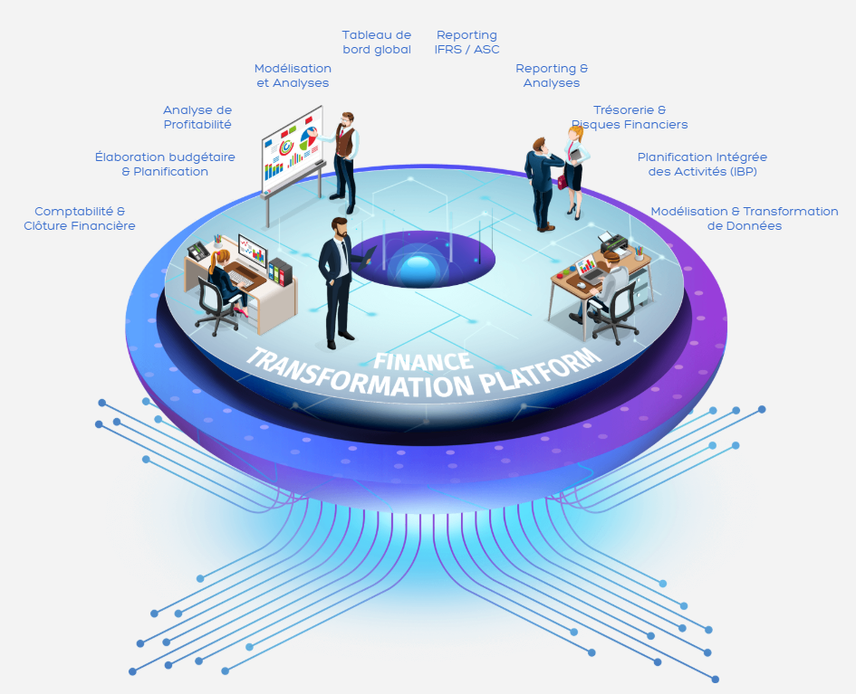
Others
From HFM to Tagetik
https://www.tagetik.com/en/beyond-hfm/beyond-hfm#.XF2Sz1xKgkJ
Legacy system VS Tagetik
https://www.tagetik.com/en/resources/videos/video-collection?utm_source=CCH%20Tagetik%20Insiders&utm_medium=Social%20Media&utm_content=Share%20a%20Link&utm_campaign=CCH%20Tagetik%20Insiders&vid=financial-consolidation-legacy-system#.XF2S0lxKgkJ

